Slide 1
River's Edge
mesbjerg@pascocountyfl.net
Reflections from a Partnership Approach Using Section 108.

Slide 2
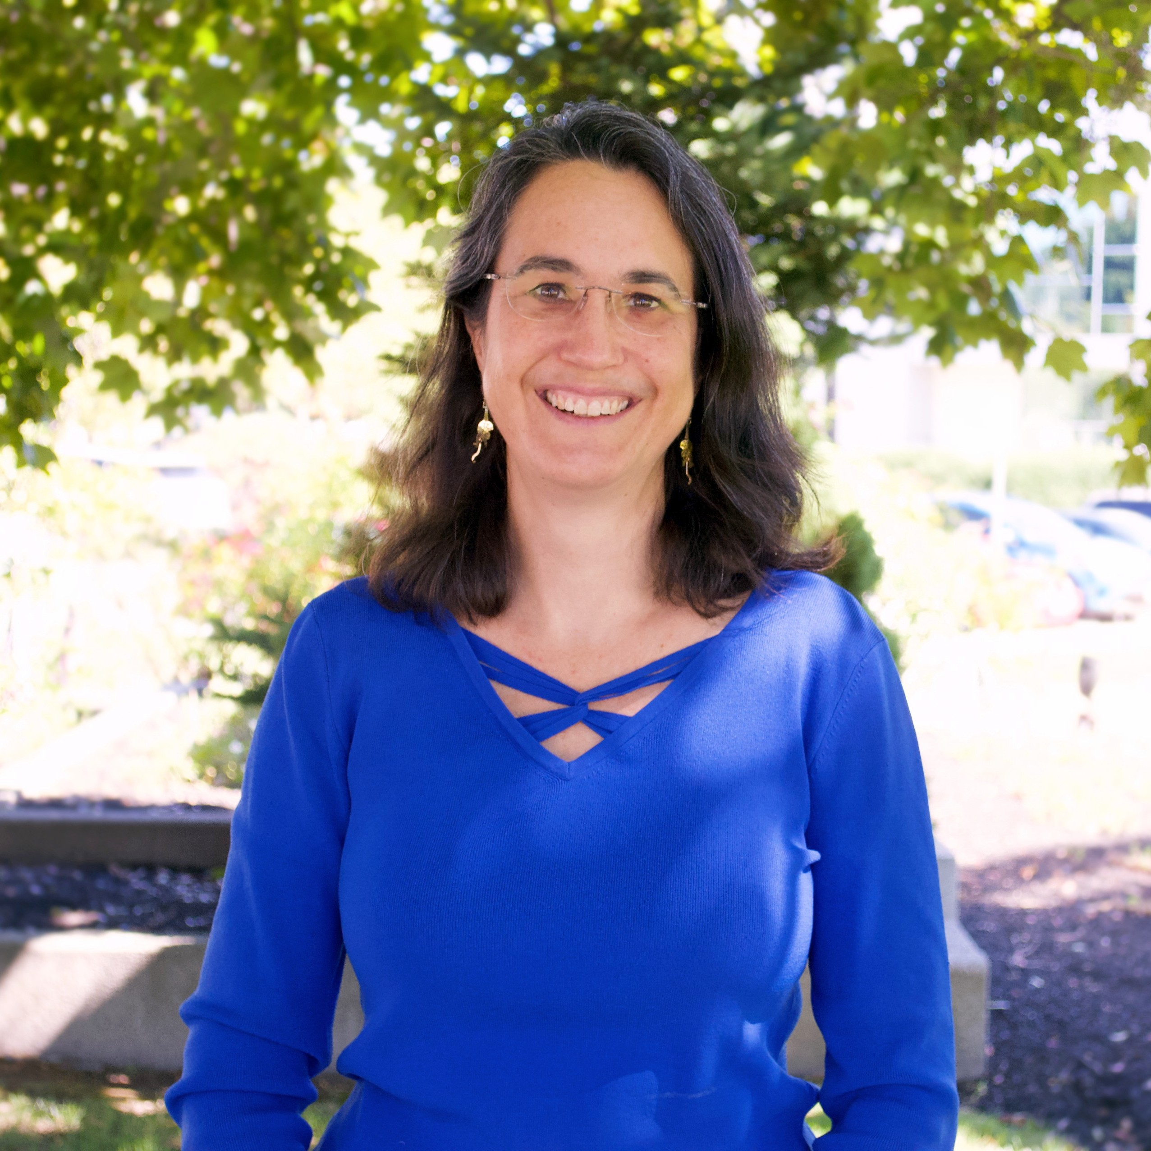
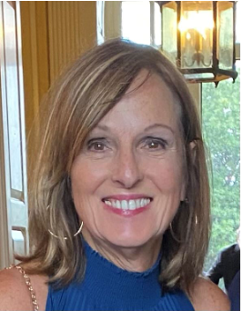
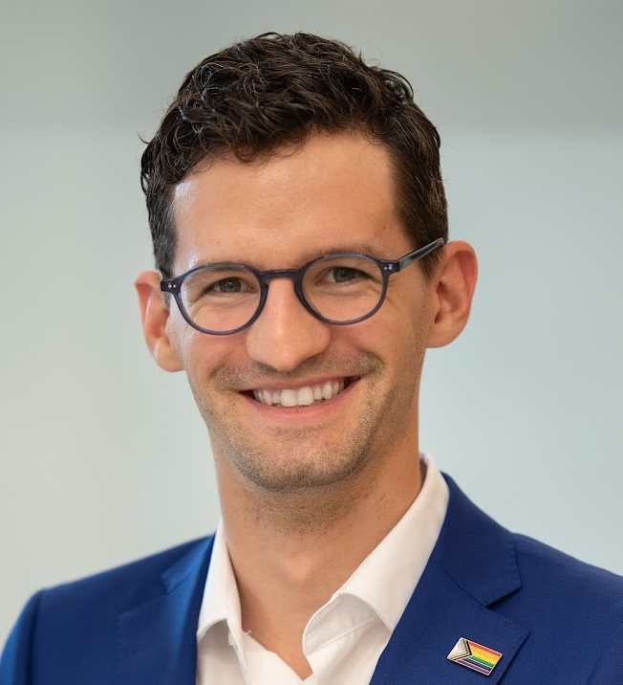
Todays Panelists
Special Guests
Alicia L Hunt
Director of Planning, Development & Sustainability
City of Medford
John Preotle
Partner, Preotle, Lane & Associates
Matt Lattanzi
Director Planning and Development / Assistant City Solicitor
City of Everett
Deborah Burke,
Director of the Office of Strategic Planning and Community Development,
City of Malden
Alex Pratt
Deputy Director, Housing and Community Development
City of Malden

Slide 3
Geographical Reference
Boston Metro Area

Slide 4
Site Location
Rivers Edge
0.4 miles from Wellington Orange Line with shuttle service to and from Rivers Edge
4.0 miles from Boston
3.5 miles from Cambridge

Slide 5
River's Edge Overview
A rich history and a bright future

Slide 6
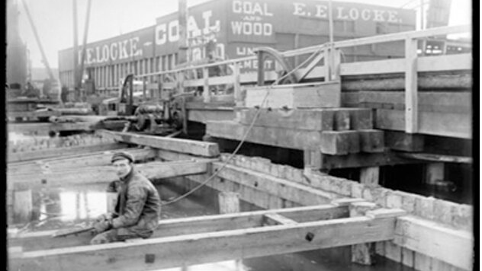
History of the site
Source: 430 Malden Images: PICRYL - Public Domain Media Search Engine Public Domain Search (getarchive.net))

Slide 7
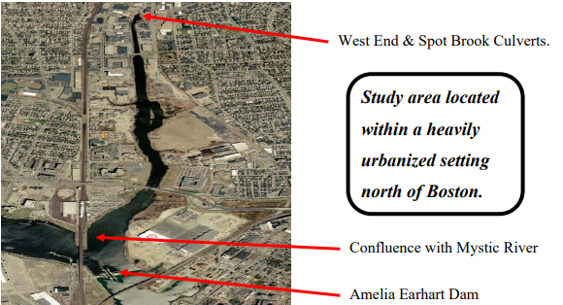
Deciding to Develop
Source: Malden River Ecosystem Restoration Detailed Project Report and Environmental Assessment (army.mil)

Slide 8
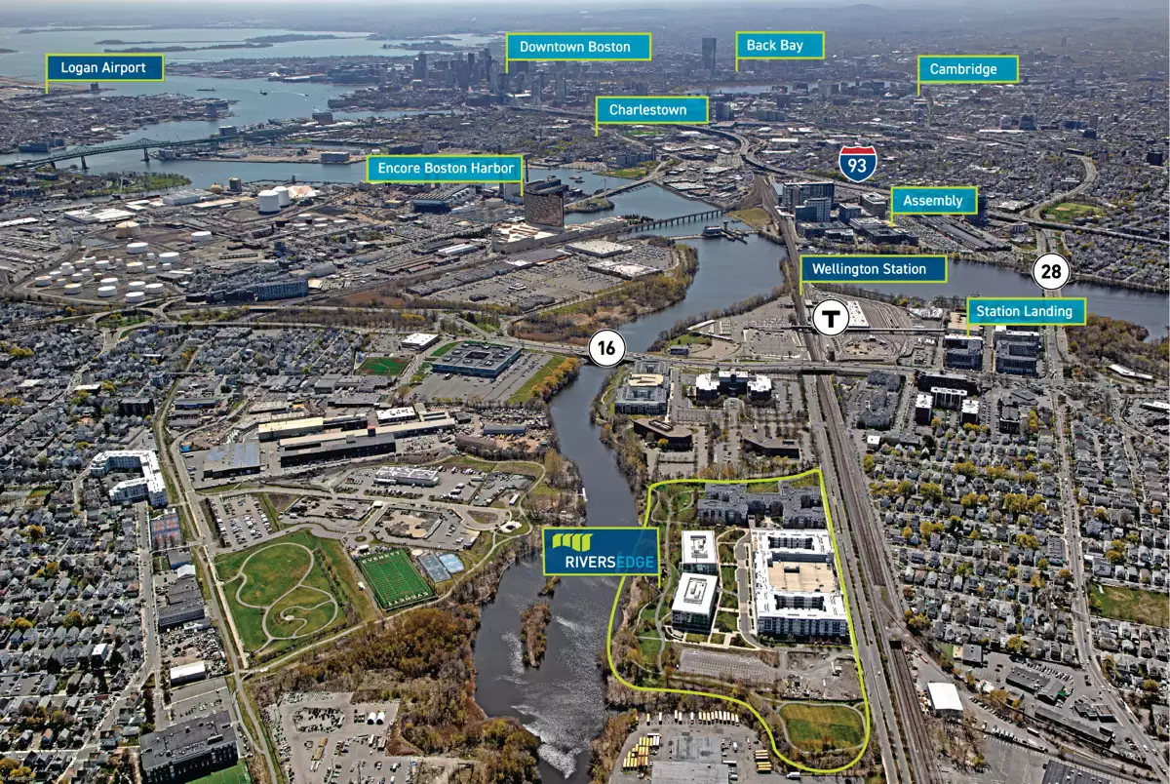
Aerial of River's Edge Site
riversedgema.com

Slide 9
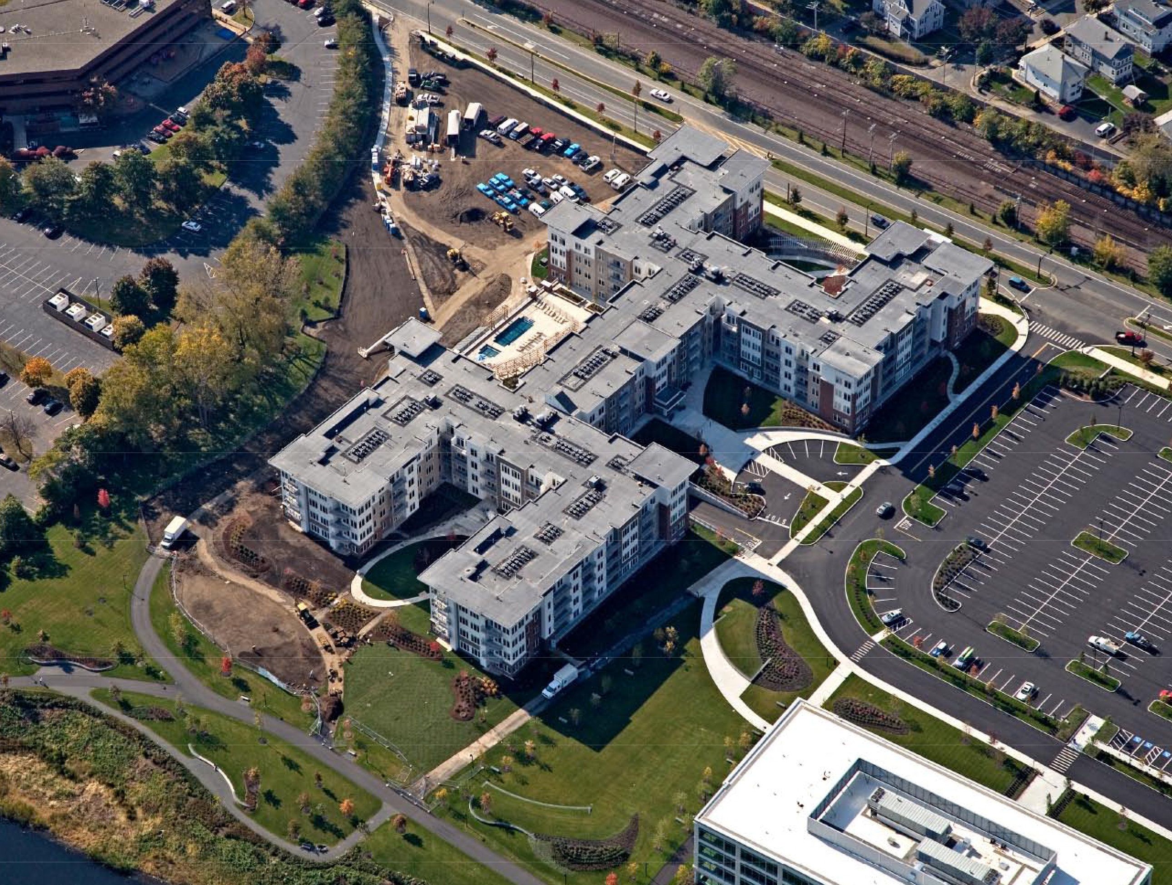

Slide 10
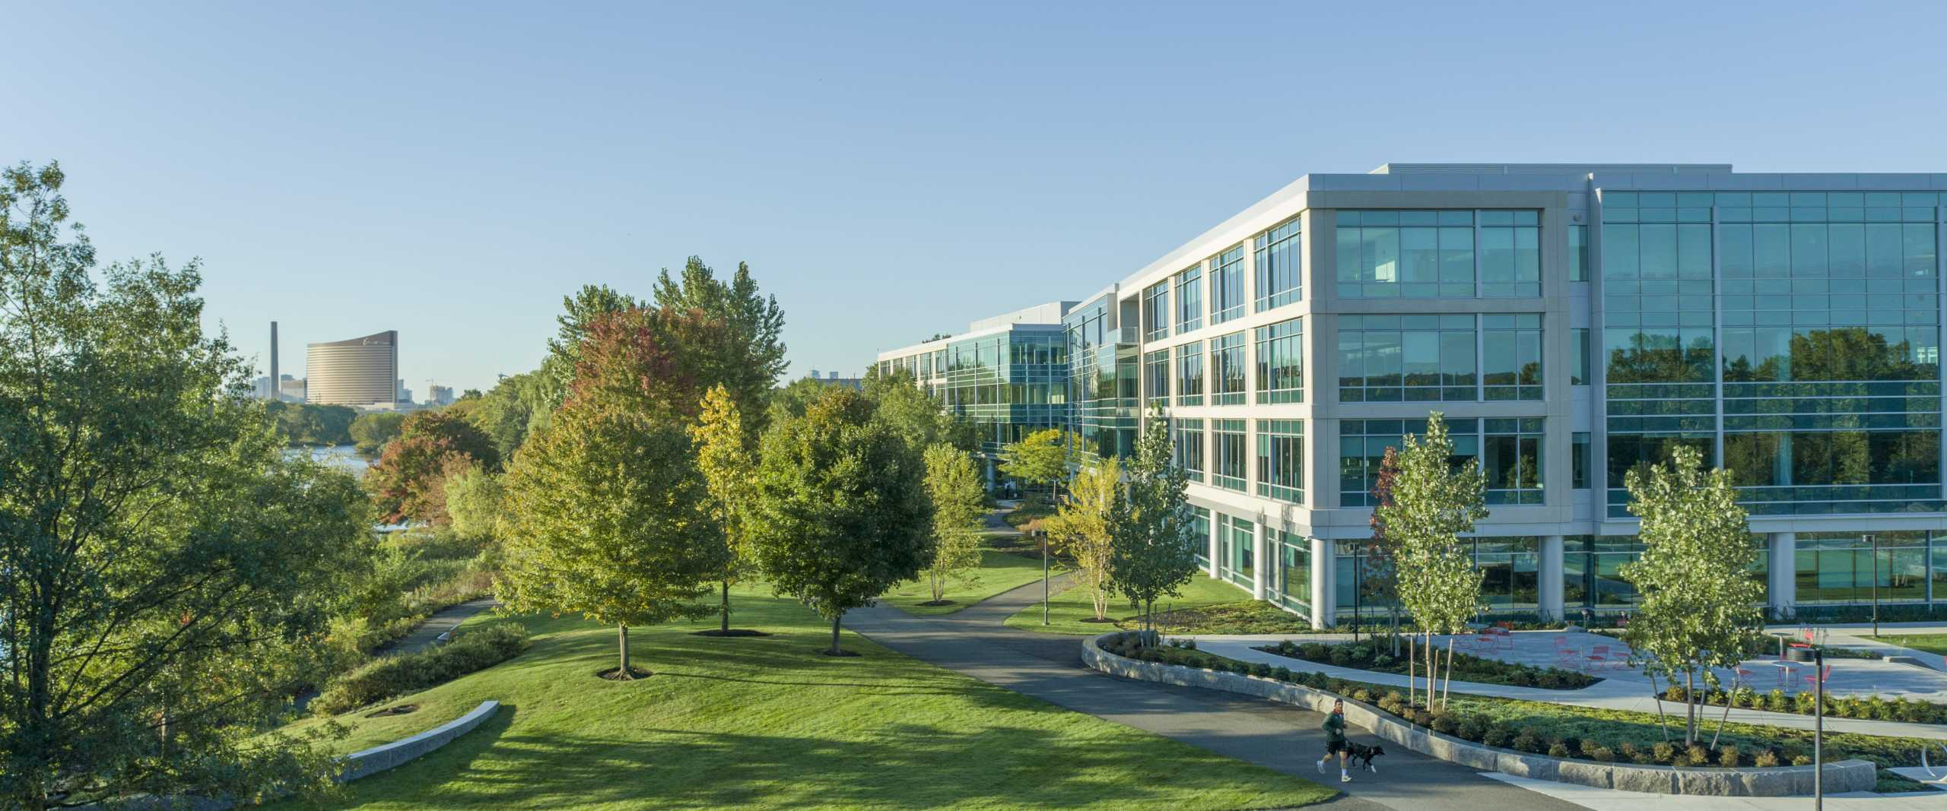

Slide 11
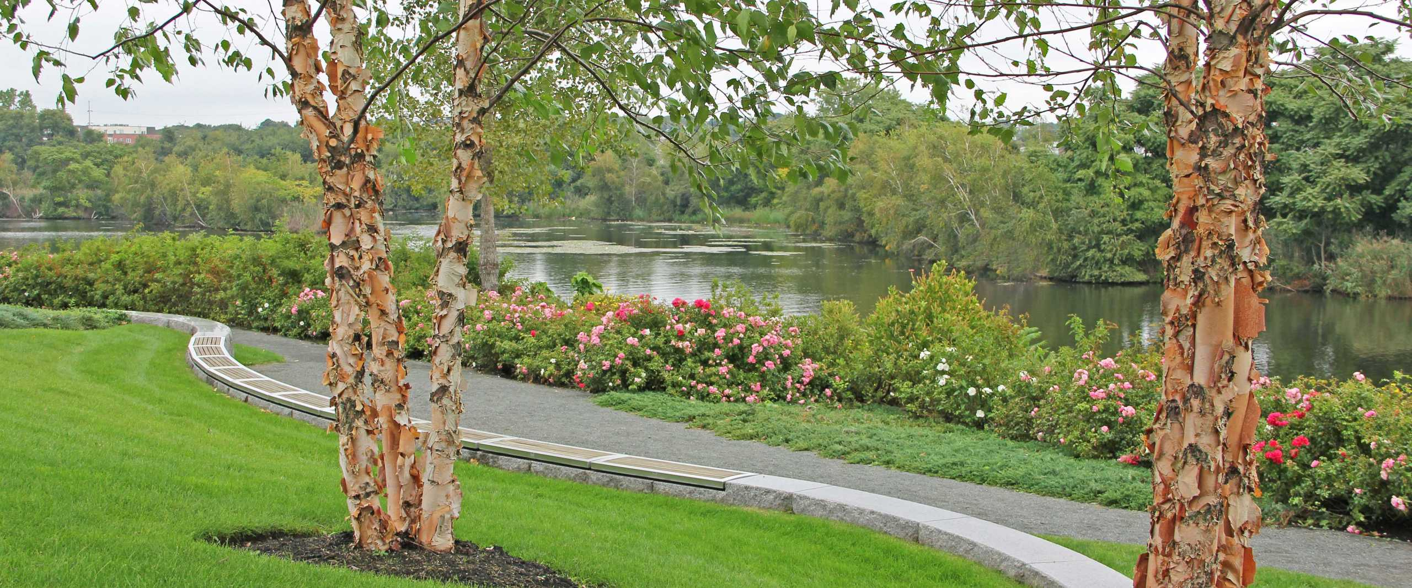

Slide 12
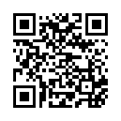
Using Section 108
Learn more here
Or visit us at:
www.HUD.gov/Section108
www.hudexchange.info/programs/section-108/
Federal Loan Guarantee Program
Allows 5X the Annual Community Development Block Grant funds
Can be used for a wide range of projects

Slide 13
Alex Pratt
Deputy Director, Housing and Community Development
City of Malden

Slide 14
Before
Barge Removal
Tire Pile

Slide 15
After
Waterfront Path
Park

Slide 16
Matt Lattanzi
Director Planning and Development / Assistant City Solicitor
City of Everett

Slide 17
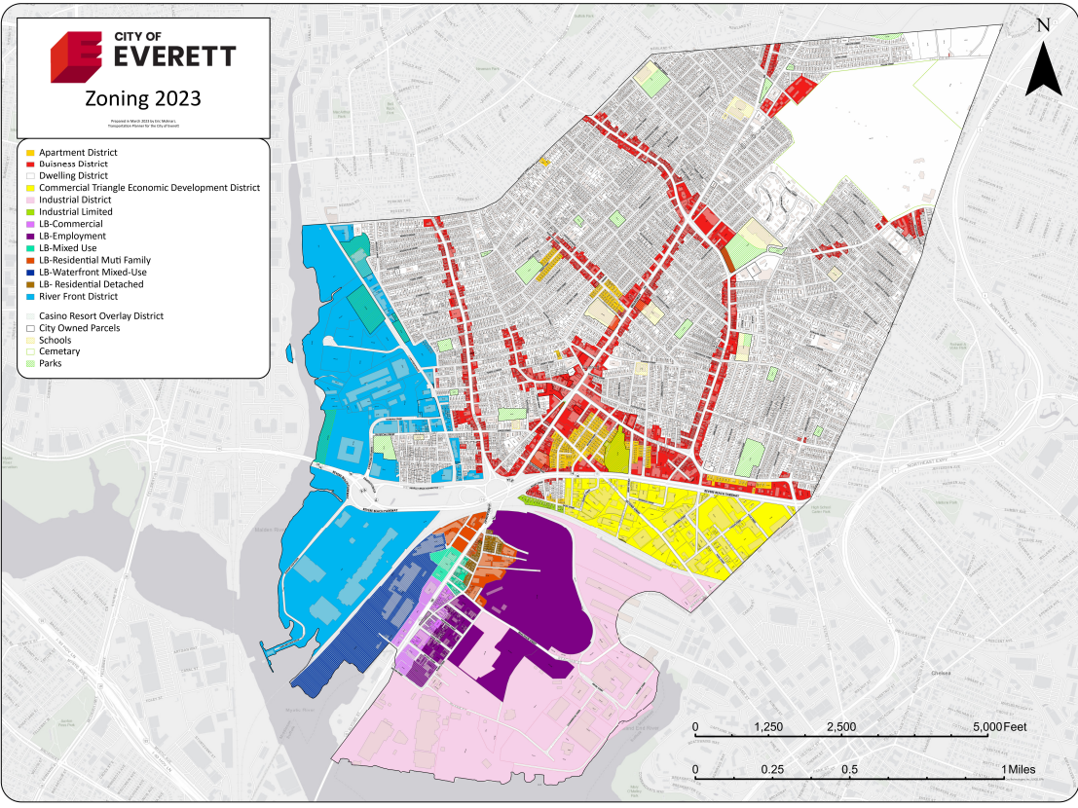

Slide 18
Alicia Hunt
Director of Planning, Development & Sustainability City of Medford

Slide 19
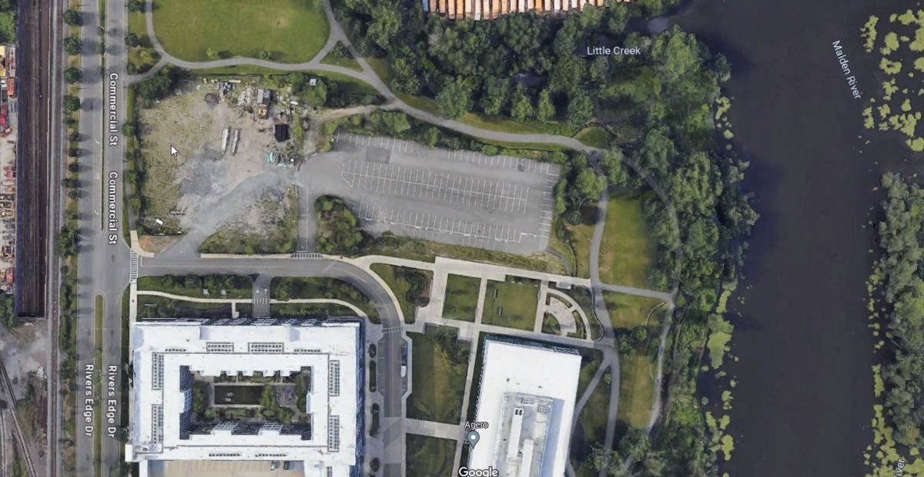

Slide 20
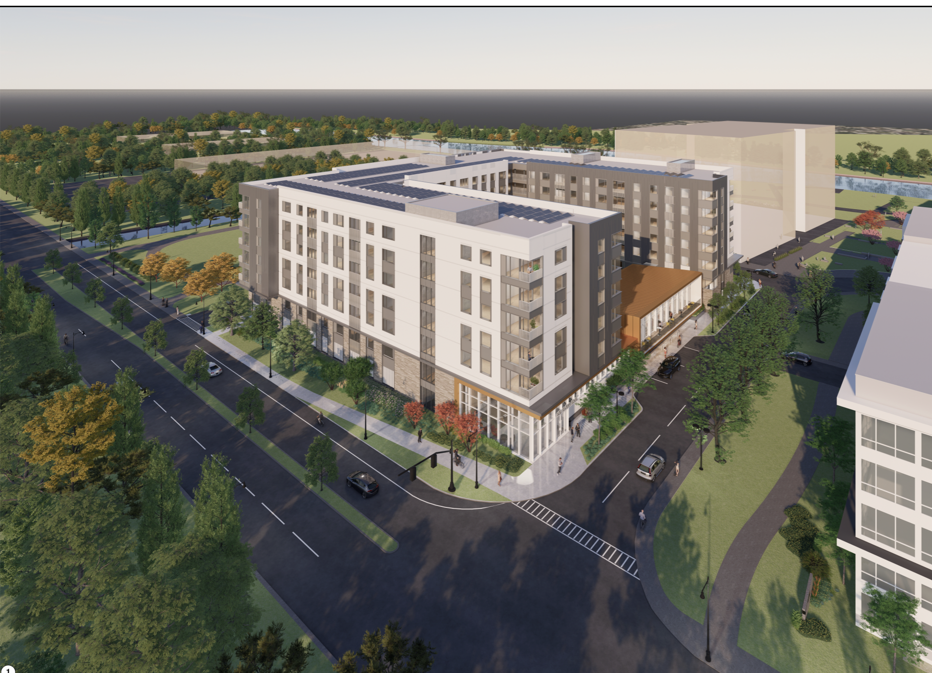

Slide 21
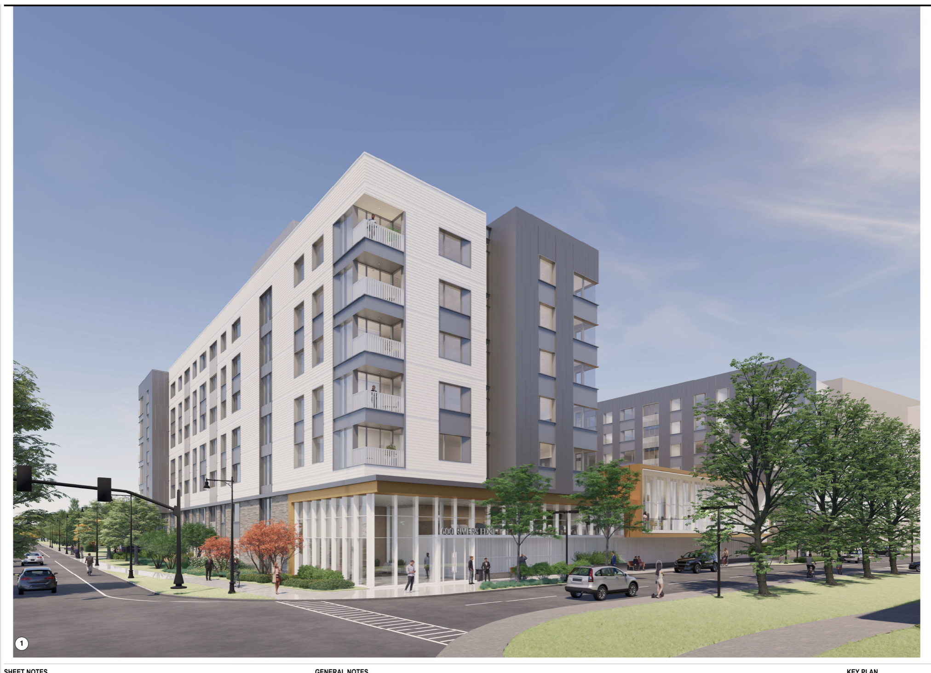

Slide 22
Questions?

